Slide 1
CS310 Operating Systems Lecture 33 : File Types – ELF (Binary), .png file (Self Reading)
Ravi Mittal
IIT Goa

Slide 2
Read the following:
Book: Modern Operating Systems, by Andrew Tanenbaum and Herbert Bos
Chapter 4
Various Internet sources

Slide 3
We will study..
Binary Files – ELF format
File Format – Example
.png file

Slide 4
Last Class

Slide 5
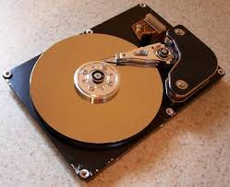
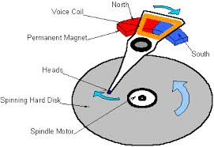
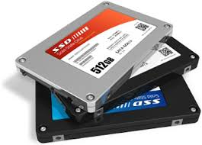

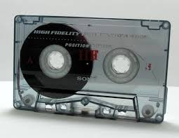
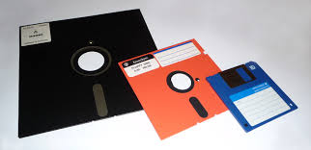
I/O and Storage Layers
Application / Service
High level concepts
High Level I/O
Streams
Low Level I/O
File Descriptors
Syscall
open(), read(), write(), close(), …
Open File Descriptions
File System
Files/Directories/Indexes
I/O Driver
Commands and Data Transfers
Disks, Flash, Controllers, DMA
CS 162, Univ of California Berkeley

Slide 6
File Structure – Three categories
Byte sequences
Maximum flexibility-can put anything in
Unix and Windows use this approach
Byte stream
Fixed length records (card images in the old days)
Read/Write operations are done on one record
Example: Based on punch cards (80 columns) – record 80 characters
Not in use
VMS OS provides highly structured file – with records
Tree of records- uses key field to find records in the tree
Tree is sorted on the key field
Used in some large mainframes
In use
Obsolete
Obsolete
Adapted from: Tanenbaum, Modern Operating Systems

Slide 7
File Structure – Three Types
Bye
sequence
Record
sequence
Tree
Adapted from: Tanenbaum, Modern Operating Systems

Slide 8
File Structure – Three Types
Bye
sequence
Record
sequence
Tree
Our focus
Adapted from: Tanenbaum, Modern Operating Systems

Slide 9
File Types
Regular Files (most common)
Text
Binary
Directories
A file that contains the names and locations of other files
Character Special and Block Special Files
Terminals (character special) and disks (block special)
FIFO (named pipe)
A file type used for inter-process communication
Socket
A file type used for network communication between processes
Adapted from: Tanenbaum, Modern Operating Systems

Slide 10
Regular Files (Linux)
On file reading or writing byte by byte
the file position increases
File position may be set manually
File position starts at zero
Writing a byte to the middle of a file overwrites over the previous byte
It is not possible to expand a file by writing into middle of it
Adapted from: Linux System Programming : Robert Love

Slide 11
File Types – Regular Files - Binary
Binary files have some internal structure
Known to programs that use them
Unix - Examples of Binary Files
Executable File Formats Library procedures (modules) that are compiled but not linked
ELF: Executable and Linkable Format
Standard le format for executables, object code, shared libraries, and core dumps
There are other formats as well: a.out, COFF, PE, Mach-O, COM, ...

Slide 12
ELF File

Slide 13
File Types – Regular Files – Binary - ELF
Unified format capable to hold any of these files
Executable files
runnable program, must have segments
gcc test.o ‐o test
Relocatable files (.o)
code and data to be linked with other object files
Must have sections
gcc ‐c test.c ‐o test.o
Shared object files (.so): libraries
links with other object files/executables
Has both segments and sections
gcc ‐c ‐fPIC shared.c
gcc ‐shared ‐o libshared.so shared.o

Slide 14
ELF: Executable and Linkable Format
Used in most Unix systems
Support different processors and data encodings
Dual nature
an ELF file is a set of segments and sections
kernel sees segments, maps them into virtual address space using mmap(2) syscall
linker sees sections, combines them into executable/shared objecte
The file divided into segments. Each segment has
Type, Requested mem location, permissions, size
Example: code segment (readable and executable)
data segments (readable and writable, or just readable)

Slide 15
ELF File Format
0
ELF header
Maps contiguous file sections to runtime memory segments
Program header table
.init
Read-only memory segment
(code segment)
.text
.rodata
.data
Read/write memory segment
(data segment)
.bss
.symtab
.debug
Symbol table and debugging info are not
loaded into memory
.line
Describes object file sections
.strtab
Section header table

Slide 16
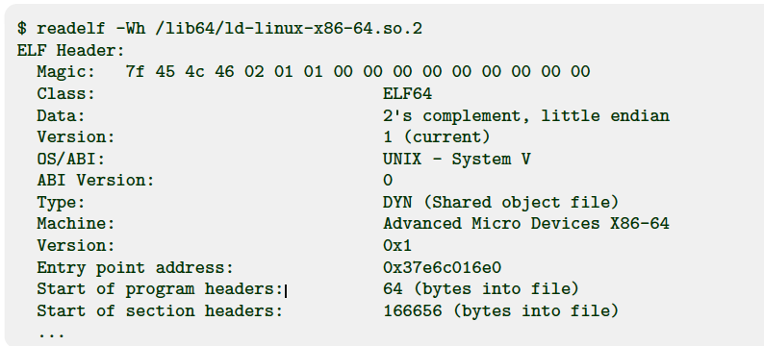
ELF File Format
ELF Header has information about
Object file type
Machine Architecture: Example: EM X86 64
Entry Point: Virtual address of entry point
Program header offset
Section Header offset
CPU – Specific flags, etc
Magic number identifies
it as an executable file

Slide 17
ELF Object File Format
Program Header Table
Tells system how to create a process in memory
Loader uses this table to load ELF segments into memory and assign permission bits
Section header table
Offsets and sizes of each section
.text section
Machine Code
.rodata section
Read only data: jump tables, string constants, ...
.data section
Initialized global variables and static c variable
.bss section
Uninitialized global variables
“Better Save Space”
Has section header but occupies no space on disk

Slide 18
ELF Object File Format (cont.)
.symtab section
Symbol table
Procedure and static variable names
Section names and locations
.debug section
Info for symbolic debugging (gcc -g)

Slide 19
File Format: Example

Slide 20
File Format - Inside
From a file system’s perspective “a file’s data is just an array of untyped byte
Leaving it up to application to interpret a file’s contents
Applications can use these bytes to store whatever information they want in whatever format they choose
Some data (in a file) have a simple structure
Example: An ASCII text file contains a sequence of bytes that can be interpreted as letters in English Alphabet
Also, data structure stored in a file can be complex
.doc file can contain text, formatting info, embedded objects, images, an ELF (Executable and Linkable File)
A database file can contain information and indices managed by a relational database

Slide 21
File types
File Extensions: An Easy Identifier
The most common way to identify the contents of a file is by the file extension
The file extension is defined as:
Something that appears after last . (dot)
Example:
sheet.png
prog1.c
prog1.h
Kkshore.kumar.mp4

Slide 22
Plain Text File
A file is considered to be a “plain.text” file when:
When file can be viewed using any ASCII/ UTF-8 characters
Does not require an spec to understand the content
All programming languages files are in plain text
.py
.c
.cpp
.js
.txt

Slide 23
Non-Plain text file
If you open a non-plain text file in plain text editor
It will appear as a garbage
Example:
.mp3, .mp4
.png, .git
.docx
How does .docx file contains a lot of information about layout, fonts, pics etc
Consider iitgoa.png file

Slide 24

Image iitgoa.png

Slide 25
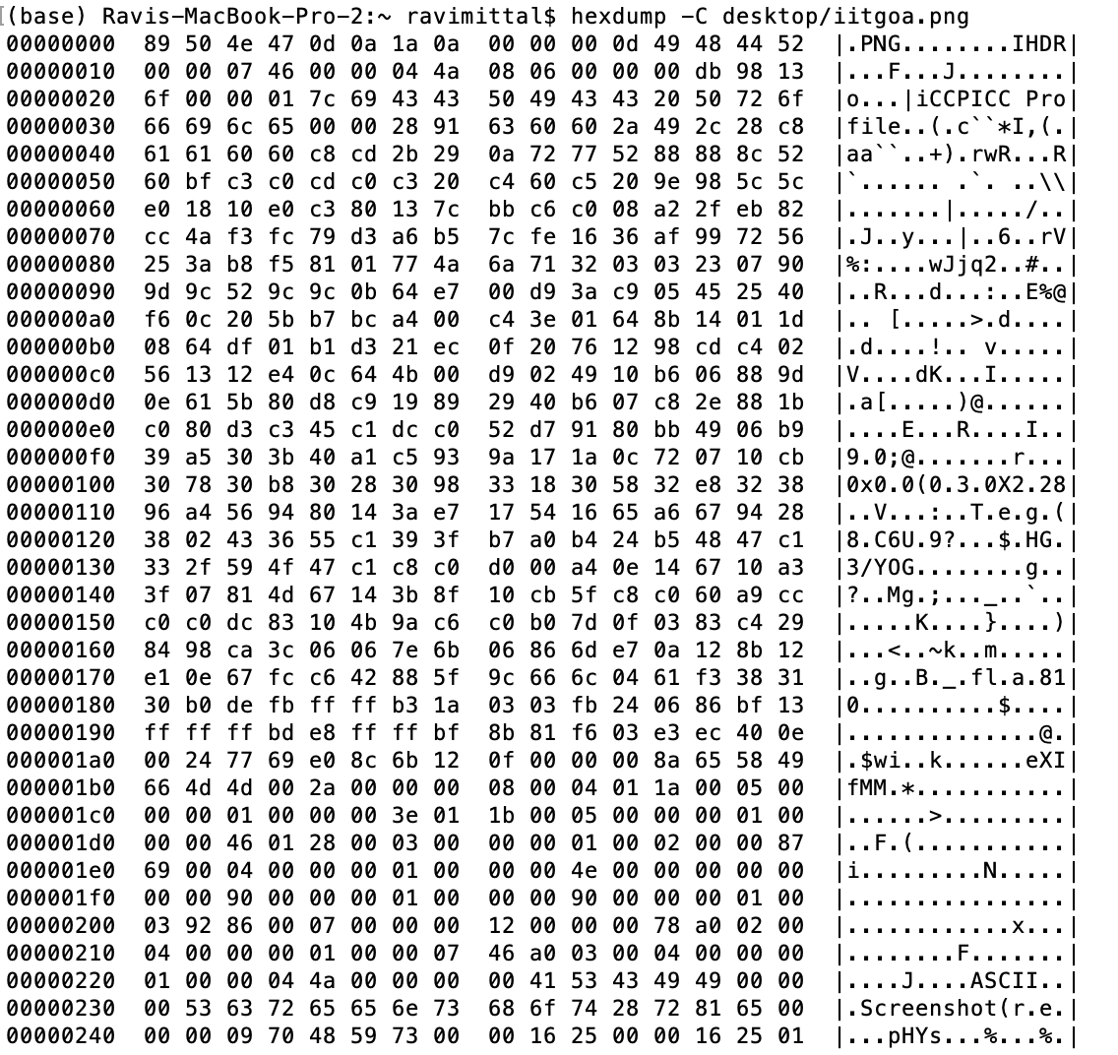
hexdump –C iitgoa.png
- C

Slide 26
PNG file format
How do we include image data in a file ?
Source: http://www.libpng.org/pub/png/spec/1.2/PNG-Structure.html
The first eight bytes of a PNG file always contain the following (decimal) values: 137 80 78 71 13 10 26 10 Hex: 89 50 4e 47 0d 0a 1a 0a
This signature indicates that the remainder of the file contains a single PNG image consisting of a series of chunks beginning with an IHDR chunk and ending with an IEND chunk.

Slide 27
Chunk Format
Each chunk consists of four parts:
Length: A 4-byte unsigned integer giving the number of bytes in the chunk's data field. The length counts only the data field, not itself, the chunk type code, or the CRC. Zero is a valid length. Although encoders and decoders should treat the length as unsigned, its value must not exceed 2³¹ bytes.
Chunk Type: A 4-byte chunk type code. For convenience in description and in examining PNG files, type codes are restricted to consist of uppercase and lowercase ASCII letters (A-Z and a-z, or 65-90 and 97-122 decimal). However, encoders and decoders must treat the codes as fixed binary values, not character strings. For example, it would not be correct to represent the type code IDAT by the EBCDIC equivalents of those letters. Additional naming conventions for chunk types are discussed in the next section.

Slide 28
Chunk Format
Chunk Data: The data bytes appropriate to the chunk type, if any. This field can be of zero length.
CRC: A 4-byte CRC (Cyclic Redundancy Check) calculated on the preceding bytes in the chunk, including the chunk type code and chunk data fields, but not including the length field. The CRC is always present, even for chunks containing no data. See CRC algorithm.

Slide 29
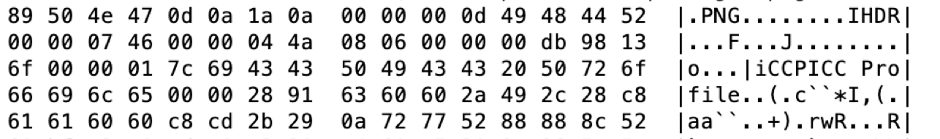
hexdump –C iitgoa.png
PNG
Length = 13
Type: IDHR
data
First chunk type: IDHR
Second chunk type: iCCP
How to interpret data ?
Learn about PNG file format, what are different chunk types, semantics of data etc

Slide 30
Lecture Summary
Binary File Format
ELF is very important format – that is currently in use for linking and Execution
Though regular files give stream of bytes, they semantics of the bytes read depend on the file type
We have studied how .png file is structured
Signature
Chunk format

